Slide 1
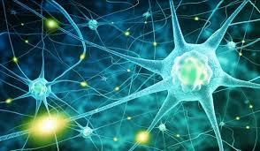
Biology
AS and A2
St Louis Grammar School
2021

Slide 2



A curiosity about ourselves and the organisms with which we share the planet is innate for many people. The intricacies of the organisation of life can be fascinating and enlightening, and the study of biology at GCE can lead to a greater understanding of and respect for living organisms.
                This qualification is for students with an interest in
                living organisms and a desire to acquire a deeper knowledge of their life processes.

Slide 3


Why study Biology?
Through exploring biology at this level, you can find out more about how organisms are built and how they function, as well as learning how they interact with each other and with their surroundings.
Biology is the study of life and, as complex living organisms ourselves, many of us are naturally drawn to find out more about how we work.

Slide 4



Not only will you discover how powerful electron microscopes have allowed us to explore plant and animal cells in detail, but you will learn about the molecules which make up these cells and see
that, even at this level of organisation, structure is inextricably linked to function in biology.
In addition to this examination of the smallest units in biology, you will also study the ‘big picture’ by learning about communities and ecosystems, as
well as the universal role of DNA in maintaining the variety of life on the planet.

Slide 5

Delve Deeper and make links
Studying AS or A level Biology will allow you to delve much deeper into the subject than when studying at GCSE level. Topics which may be familiar to you from GCSE are studied in much more detail and are updated with contemporary developments in the subject.
In addition, new topics such as biochemistry and molecular biology will help to give you a deeper understanding of the subject as a whole and make links between different areas of biology.

Slide 6

What skills will I develop?
As with the other sciences, biology helps you to build up research, problem solving, organisation and analytical skills.
If you study biology, you will likely find yourself working on group projects, which will help you build your teamwork and communication skills too.
You will develop skills in analysis, evaluation and research. You will also develop an ability to understand complex processes, along with practical skills such as using a microscope, carrying out fieldwork and handling apparatus.

Slide 7
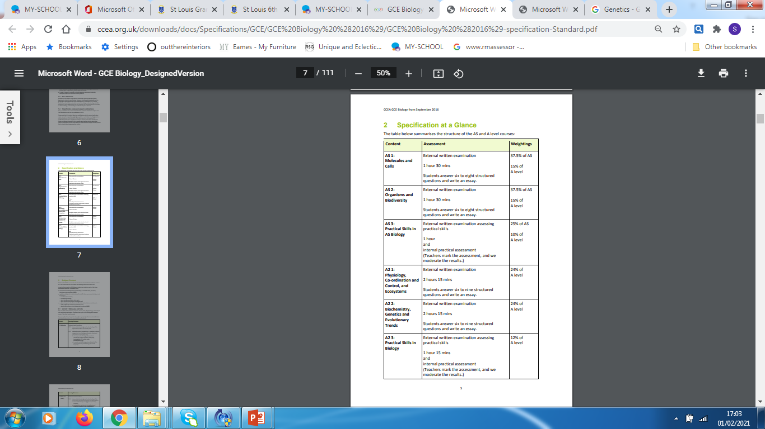
The Course Content
What will I study?
The CCEA GCE Biology specification gives students a deeper knowledge of the organisms that share our planet. They learn about how organisms are built, how they function and how they interact with each other and their surroundings.
Students carry out and report on practical activities that are designed to help them understand concepts and processes and demonstrate biological phenomena.

Slide 8

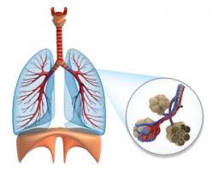
AS Biology
In AS.1: You will delve deeper into the world of molecules, enzymes, viruses, cells, cell physiology, continuity of cells, and tissues and organs.
AS.2 This unit covers transport and exchange mechanisms in plants and mammals, adaptations of organisms and biodiversity with an emphasis on local contexts.

Slide 9

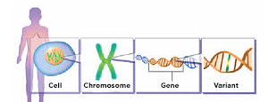
A2 Biology
A2.1: This unit covers homeostasis including the kidney and excretion, immunity, co-ordination and control in plants and animals, and ecosystems.
A2:2 This unit covers the biochemical processes of respiration and photosynthesis. Students explore genetics on a number of levels: DNA as the genetic code, gene technology, patterns of inheritance and the mechanism of change in population genetics that contributes to evolutionary trends.

Slide 10


Career Paths in Biology
Knowledge of biological processes has implications for a wide range of fundamentally important areas. Furthermore, a qualification in biology may be a recommendation or a prerequisite for entering further study in the fields of medicine, nursing, dentistry, veterinary science, speech and language therapy, pharmacology, physiology, biomedical science, forensic science and agriculture.

Slide 11



Health Care

Slide 12



Food Industry

Slide 13


Conservation

Slide 14


Technology

Slide 15


Biology in St Louis.
A level Biology has long been a popular choice for A level students in St Louis.
You will be taught the course in a happy and stimulating learning environment.
Over the years, many of our past students have gone on to have successful careers in a wide range of disciplines.

Slide 16

So why choose Biology ?
“Bio” means Life
“logy” is the study of
Biology is the study of life!!!!!
What can be more important?
Thank you

